Slide 1
Atlas Meeting 13
Yihao Chen

Slide 2
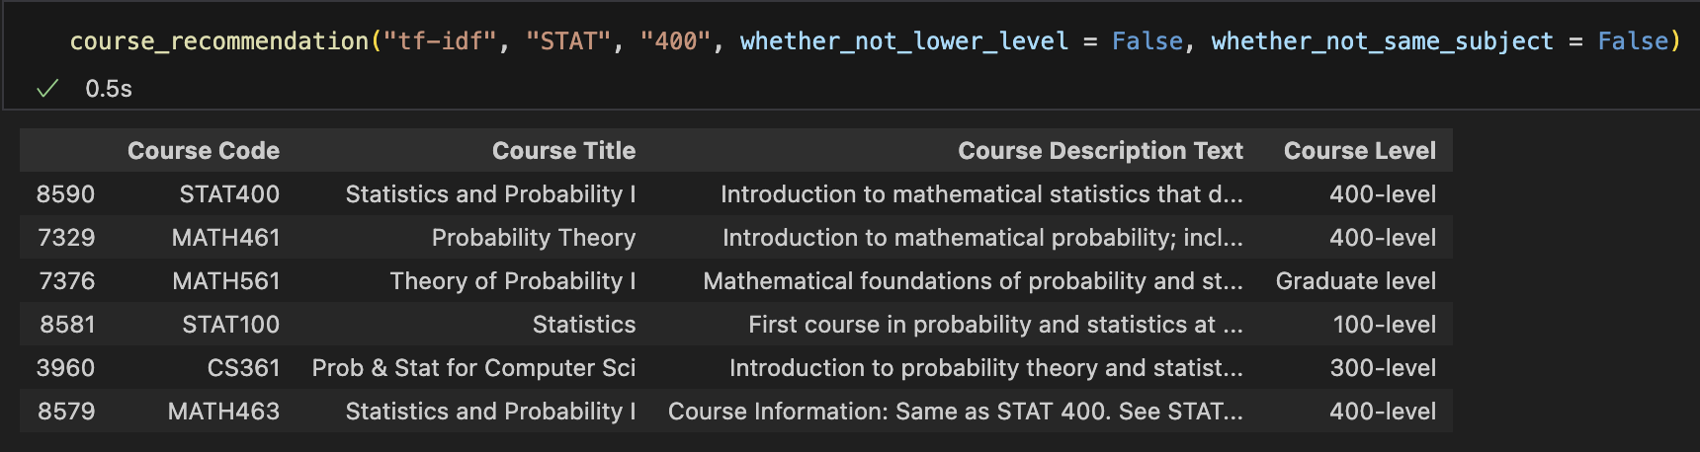
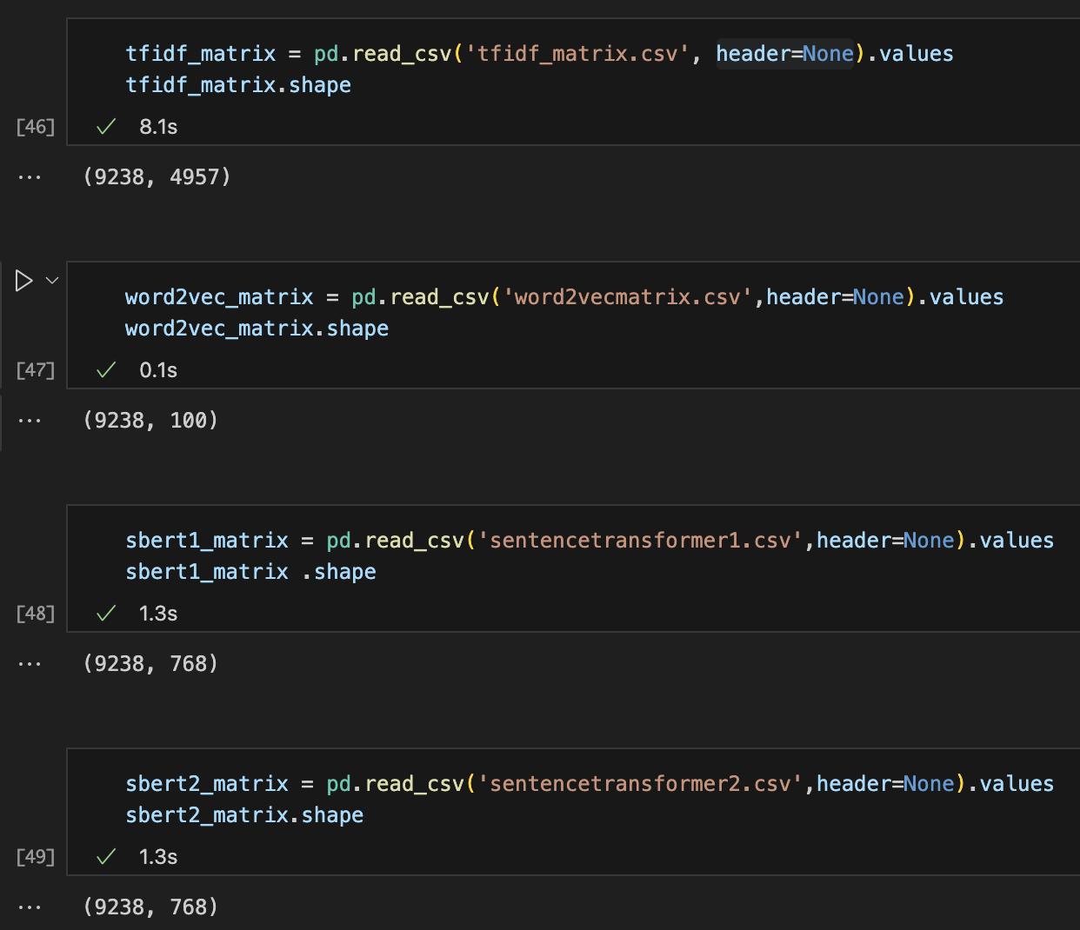
Function Wrap-up
Document matrix for all previous models.
tf-idf
word2vex
sbert1: paraphrase-distilroberta-base-v1
sbert2: all-mpnet-base-v2
Adding filtering features:
Whether only show current and higher- level courses.
Whether only show results of other subject.

Slide 3
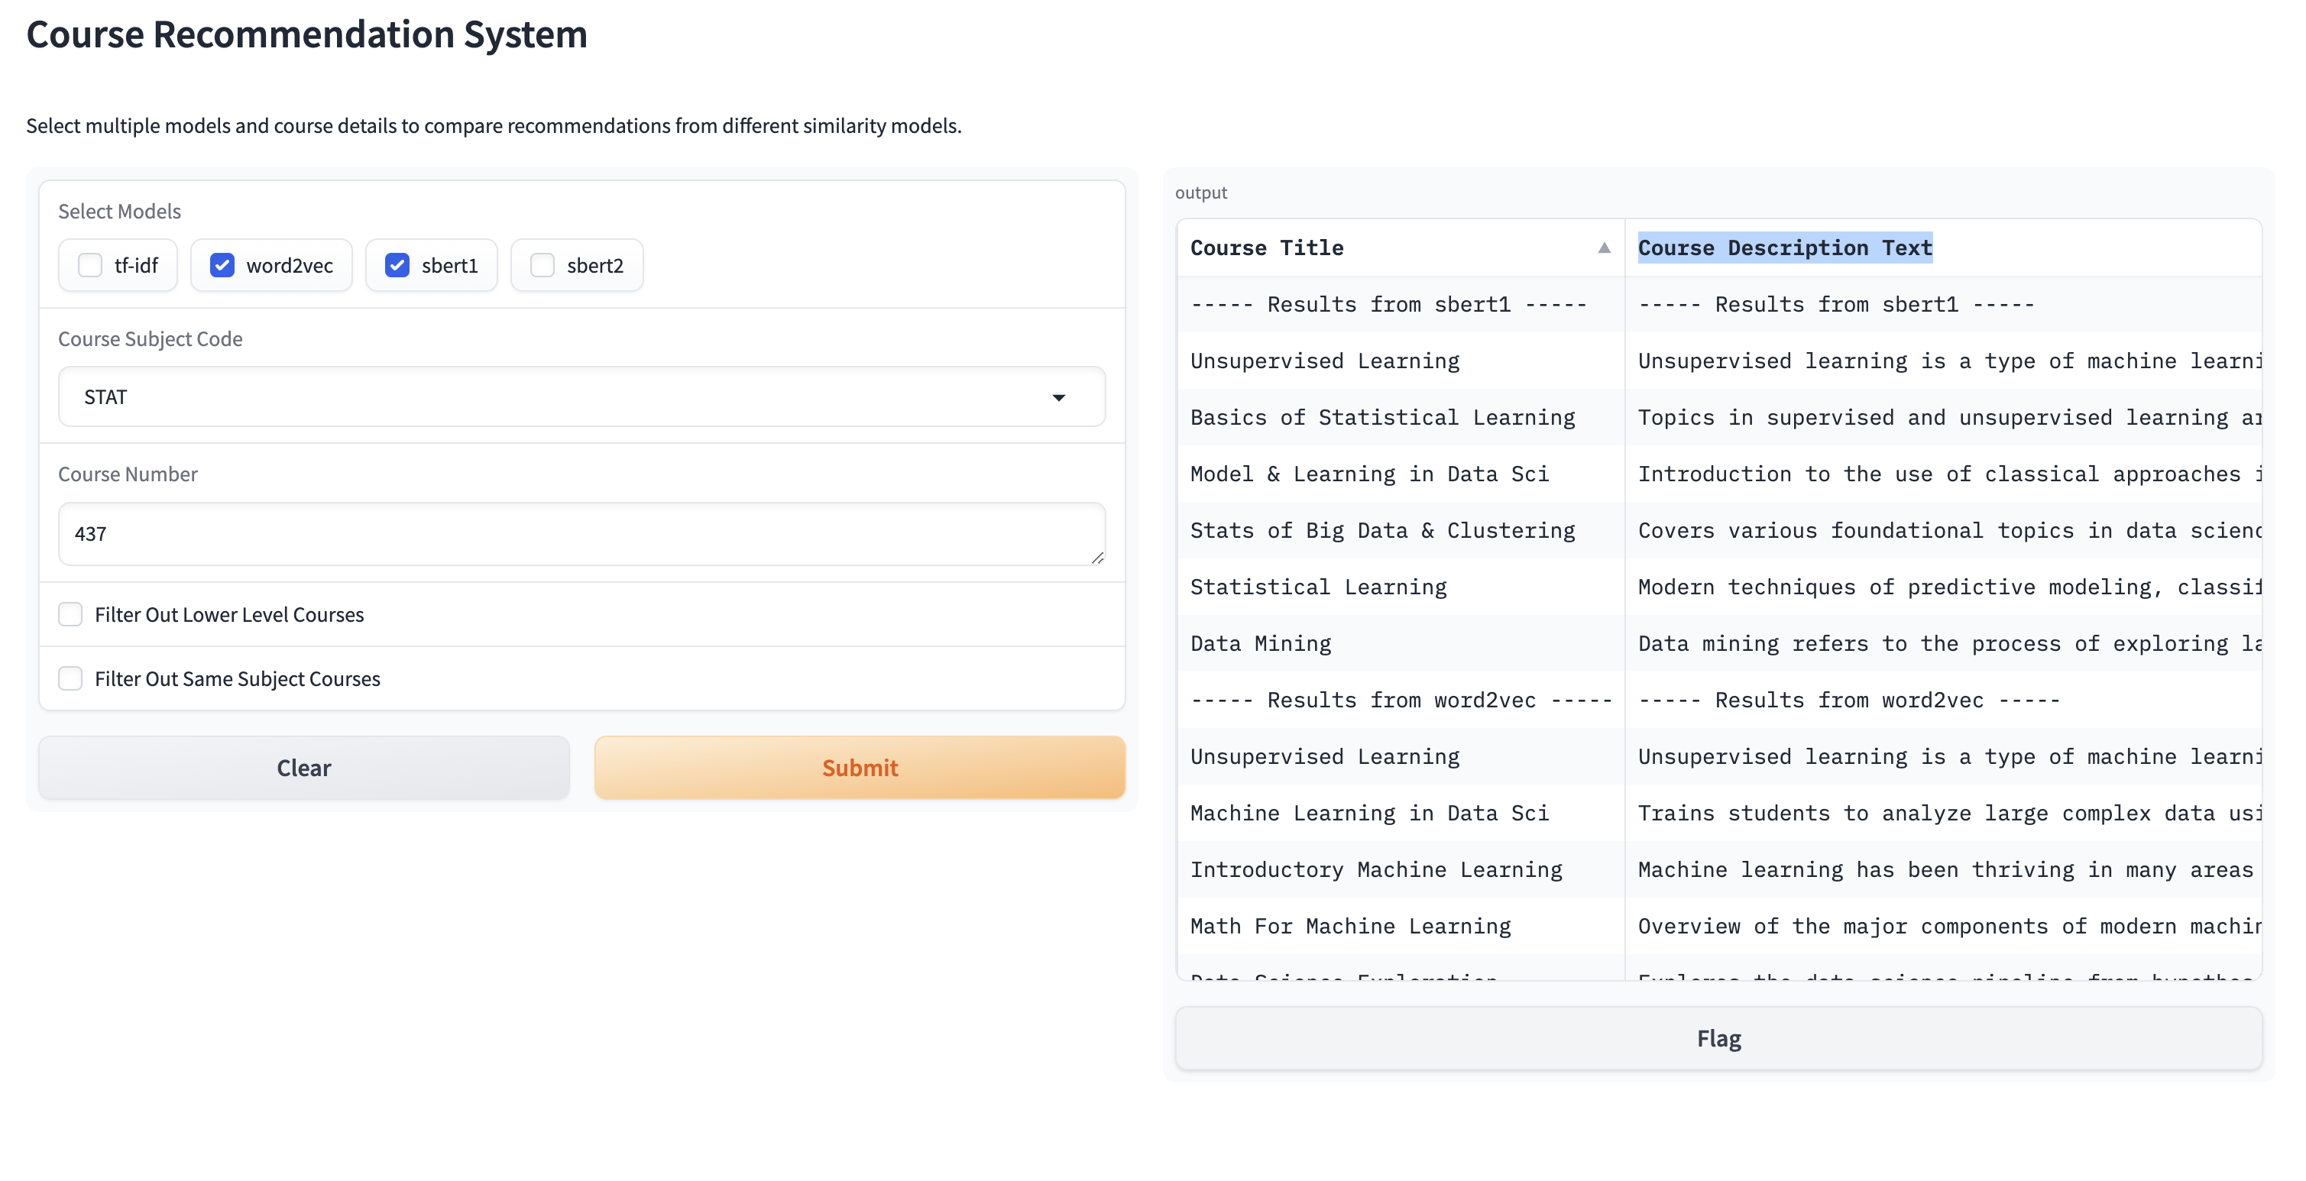
Gradio set-up
http://127.0.0.1:7883
Some current issues:
Really long texts
Separators between

Slide 4
Takaways and todos
Adding PCA based scatterplots with outputs highlighted in the interface
Enhance interface layout:
  Dive into CSS settings to wrap text for description, or find alternative way to show recommendation results
Adding introduction for different models
cpanel

